Slide 1
Fundamentos de las Comunicaciones
Práctica 3

Slide 2

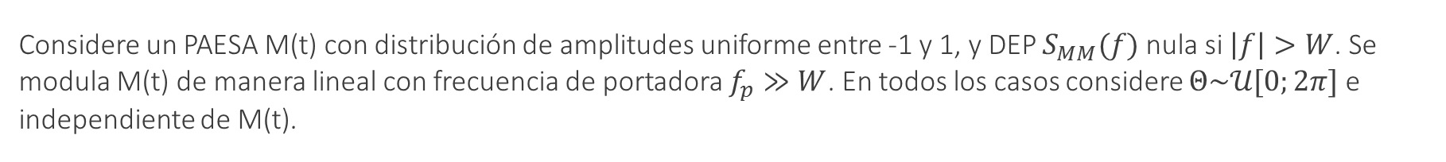
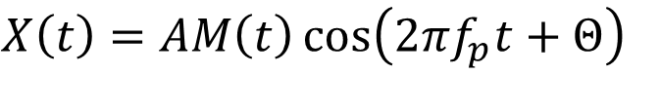


Modulación lineal con señales aleatorias
Considere un PAESA M(t) con distribución de amplitudes uniforme entre -1 y 1, y DEP $S_{MM}(f)$ nula si $\left|f\right|>W$. Se modula M(t) de manera lineal con frecuencia de portadora $f_{p}≫W$. En todos los casos considere $Θ\sim 𝒰[0;2π]$ e independiente de M(t).
a) DBL-PS
$$M(t)$$
$$X(t)$$
$$X\left(t\right)=AM\left(t\right)\cos\left(2πf_{p}t+Θ\right)$$
PAESA:
E{X(t)} = µ_{x}
R_{XX}(t+τ,t)= R_{XX}(τ)
$$A\cos{(2πf_{c}t)}$$

Slide 3

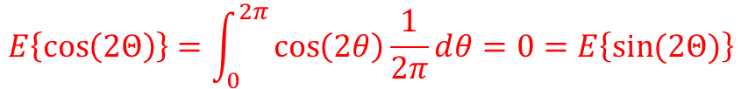
Primero calculamos la autocorrelación:
$$R_{XX}(t+τ,t)=E\left\{AM\left(t+τ\right)\cos\left(2πf_{p}\left(t+τ\right)+Θ\right)AM\left(t\right)\cos\left(2πf_{p}t+Θ\right)\right\}$$
$$=\frac{A^{2}}{2}E\left\{M\left(t+τ\right)M\left(t\right)\left[\cos\left(4πf_{p}t+2πf_{p}τ+2Θ\right)+\cos\left(2πf_{p}τ\right)\right]\right\}$$
$$=\frac{A^{2}}{2}E\left\{M\left(t+τ\right)M\left(t\right)\right\}\left[E\left\{\cos\left(4πf_{p}t+2πf_{p}τ+2Θ\right)\right\}+cos\left(2πf_{p}τ\right) \right]$$
$$R_{MM}(τ)$$
$$E\left\{\cos\left(2Θ\right)\right\}=\int_{0}^{2π}{\cos\left(2θ\right)\frac{1}{2π}ⅆθ}=0=E\left\{\sin{(2Θ)}\right\}$$
$R_{XX}(t+τ,t)=R_{XX}(τ)=$ $\frac{A^{2}}{2}R_{MM}(τ)\cos\left(2πf_{p}τ\right)$

Slide 4
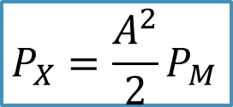
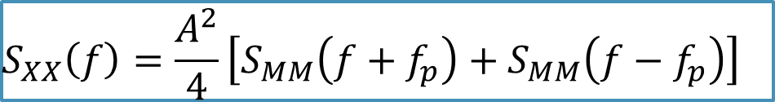
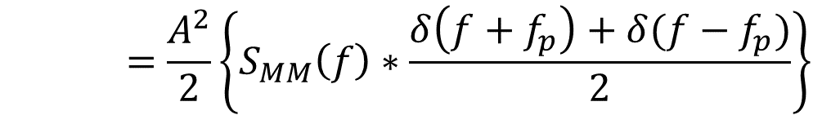

Calculamos la media:
$$0$$
$$E\left\{X\left(t\right)\right\}=E\left\{AM\left(t\right)\cos\left(2πf_{p}t+Θ\right)\right\}=AE\left\{M\left(t\right)\right\}E\left\{\cos\left(2πf_{p}t+Θ\right)\right\}=0$$
Tanto la media como la autocorrelación no dependen del tiempo
X(t) es PAESA
Obtenemos la densidad espectral de potencia:
$S_{XX}\left(f\right)=ℱ\left\{R_{XX}(τ)\right\}=$ $ℱ\left\{\frac{A^{2}}{2}R_{MM}(τ)\cos\left(2πf_{p}τ\right)\right\}$
$$=\frac{A^{2}}{2}\left\{S_{MM}\left(f\right)∗\frac{δ\left(f+f_{p}\right)+δ(f−f_{p})}{2}\right\}$$
$$S_{XX}\left(f\right)=\frac{A^{2}}{4}\left[S_{MM}\left(f+f_{p}\right)+S_{MM}\left(f−f_{p}\right)\right]$$
$$P_{X}=\frac{A^{2}}{2}P_{M}$$

Slide 5


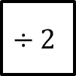
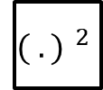
¿Cómo podemos demodular?
Demodulación coherente
$$X(t)$$
$$\hat{M}(t)$$
$${( .) }^{2}$$
$$÷2$$

Slide 6




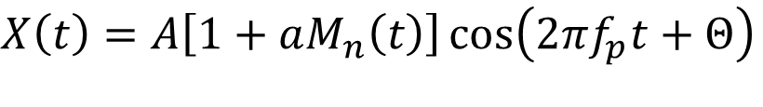

Modulación lineal con señales aleatorias
b) AM
$$M(t)$$
$$X(t)$$
$$X\left(t\right)=A\left[1+aM_{n}\left(t\right)\right]\cos\left(2πf_{p}t+Θ\right)$$
$$1$$
$$A\cos{(2πf_{p}t+Θ)}$$
$$M_{n}\left(t\right)=\frac{M\left(t\right) }{\left|min⁡\{M\left(t\right)\}\right|}$$

Slide 7
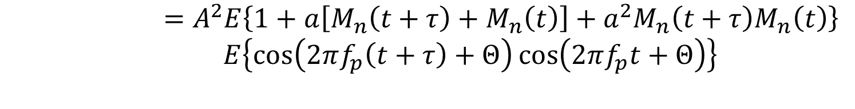

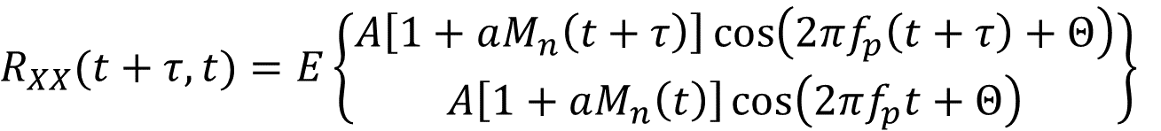


Primero calculamos la autocorrelación:
$$R_{XX}(t+τ,t)=E\left\{\begin{aligned}A\left[1+aM_{n}\left(t+τ\right)\right]\cos\left(2πf_{p}\left(t+τ\right)+Θ\right) \\ A\left[1+aM_{n}\left(t\right)\right]\cos\left(2πf_{p}t+Θ\right)\end{aligned}\right\}$$
$$0$$
$$0$$
$$=A^{2}E\left\{1+a\left[M_{n}\left(t+τ\right)+M_{n}\left(t\right)\right]+a^{2}M_{n}\left(t+τ\right)M_{n}\left(t\right)\right\}$$
$E\left\{\cos\left(2πf_{p}\left(t+τ\right)+Θ\right)\cos\left(2πf_{p}t+Θ\right)\right\}$
$$⋮$$
$R_{XX}(t+τ,t)=R_{XX}(τ)=$ $\frac{A^{2}}{2}\left(1+a^{2}R_{MM}(τ)\right)\cos\left(2πf_{p}τ\right)$
Calculamos la media:
$$E\left\{X\left(t\right)\right\}=E\left\{A\left[1+aM_{n}\left(t\right)\right]\cos\left(2πf_{p}t+Θ\right)\right\}$$
$$=AE\left\{1+aM_{n}\left(t\right)\right\}E\left\{\cos\left(2πf_{p}t+Θ\right)\right\}=0$$
Tanto la media como la autocorrelación no dependen del tiempo
X(t) es PAESA

Slide 8
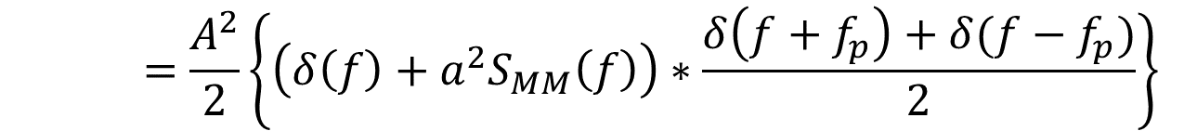
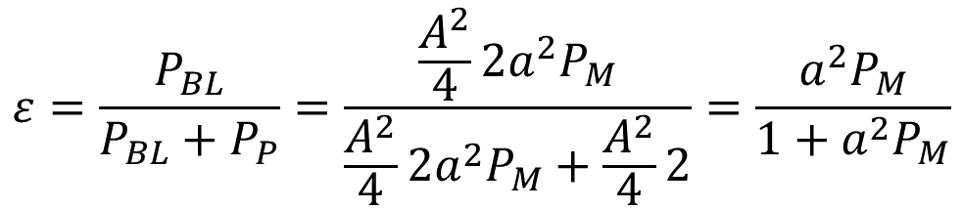
Obtenemos la densidad espectral de potencia:
$S_{XX}\left(f\right)=ℱ\left\{R_{XX}(τ)\right\}=$ $ℱ\left\{\frac{A^{2}}{2}\left(1+a^{2}R_{MM}(τ)\right)\cos\left(2πf_{p}τ\right)\right\}$
$$=\frac{A^{2}}{2}\left\{\left(δ\left(f\right)+a^{2}S_{MM}\left(f\right)\right)∗\frac{δ\left(f+f_{p}\right)+δ(f−f_{p})}{2}\right\}$$
$$S_{XX}\left(f\right)=\frac{A^{2}}{4}\left[δ\left(f+f_{p}\right)+δ\left(f−f_{p}\right)+a^{2}\left(S_{MM}\left(f+f_{p}\right)+S_{MM}\left(f−f_{p}\right)\right)\right]$$
Podemos calcular la eficiencia como la relación entre la potencia de las bandas laterales (mensaje) y la potencia total (mensaje + portadora):
$$ε=\frac{P_{BL}}{P_{BL}+P_{P}}=\frac{\frac{A^{2}}{4}2a^{2}P_{M}}{\frac{A^{2}}{4}2a^{2}P_{M}+\frac{A^{2}}{4}2}=\frac{a^{2}P_{M}}{1+a^{2}P_{M}}$$

Slide 9
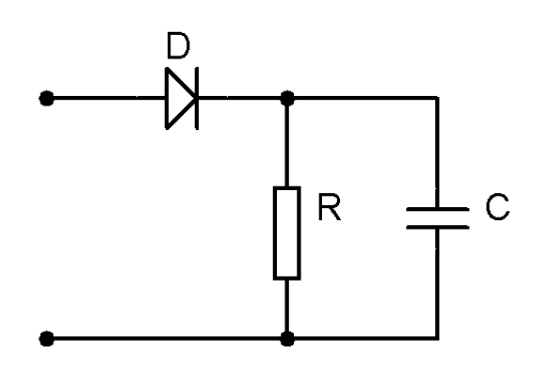



¿Cómo podemos demodular?
Demodulación coherente
$$X(t)$$
$$\hat{M}(t)$$
Debo recuperar la portadora
O bien, si el índice de modulación $a<1$:
Demodulación no coherente con detector de envolvente

Slide 10
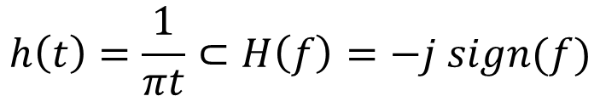



Modulación lineal con señales aleatorias
c) Transformada de Hilbert
$$h\left(t\right)=\frac{1}{πt}⊂H\left(f\right)=−j sign(f)$$
- Rota componentes π/2
- Elimina componente continua
$$\hat{M}\left(t\right)= ℋ\left\{M\left(t\right)\right\}$$
$$1$$
$$S_{\hat{M}\hat{M}}\left(f\right)=S_{MM}\left(f\right){\left|H\left(f\right)\right|}^{2}=S_{MM}\left(f\right)$$
$$S_{\hat{M}M}\left(f\right)=ℱ\left\{\left\{R_{MM}∗h\right\}(τ)\right\}=−j sign(f)S_{MM}\left(f\right)$$

Slide 11

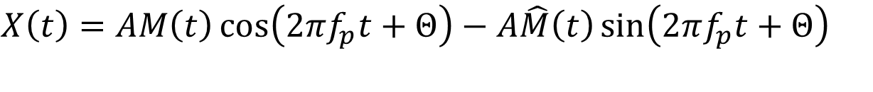


Modulación lineal con señales aleatorias
b) BLU-S
$$M(t)$$
$$X\left(t\right)=AM\left(t\right)\cos\left(2πf_{p}t+Θ\right)−A\hat{M}\left(t\right)\sin\left(2πf_{p}t+Θ\right)$$
$$A\cos{(2πf_{p}t+Θ)}$$
$$X(t)$$
$$ℋ$$
$$π/2$$

Slide 12
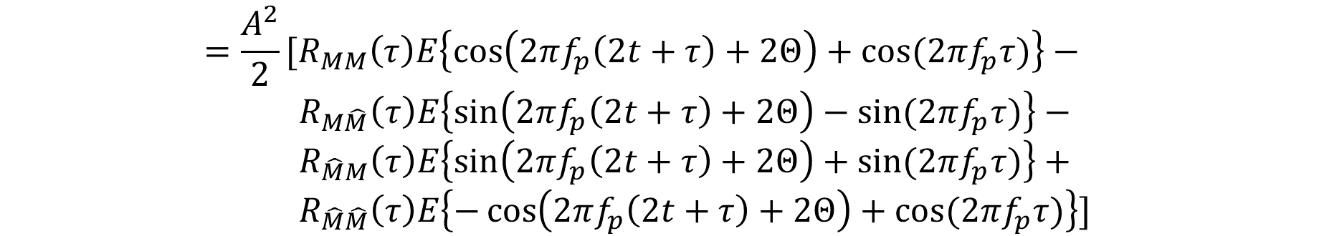
El procedimiento para obtener autocorrelación y densidad espectral de potencia es el mismo:
$$R_{XX}\left(t+τ,t\right)=E\{A\left[M\left(t+τ\right)\cos\left(2πf_{p}\left(t+τ\right)+Θ\right)−\hat{M}\left(t+τ\right)\sin\left(2πf_{p}\left(t+τ\right)+Θ\right)\right].$$
$A\left[M\left(t\right)\cos\left(2πf_{p}t+Θ\right)−\hat{M}\left(t\right)\sin\left(2πf_{p}t+Θ\right)\right]\}$
$$=\frac{A^{2}}{2}[R_{MM}\left(τ\right)E\left\{\cos\left(2πf_{p}\left(2t+τ\right)+2Θ\right)+\cos{(2πf_{p}τ)}\right\}−$$
$$R_{M\hat{M}}\left(τ\right)E\left\{\sin\left(2πf_{p}\left(2t+τ\right)+2Θ\right)−\sin{(2πf_{p}τ)}\right\}−$$
$$R_{\hat{M}M}\left(τ\right)E\left\{\sin\left(2πf_{p}\left(2t+τ\right)+2Θ\right)+\sin{(2πf_{p}τ)}\right\}+$$
$$R_{\hat{M}\hat{M}}\left(τ\right)E\left\{−\cos\left(2πf_{p}\left(2t+τ\right)+2Θ\right)+\cos{(2πf_{p}τ)}\right\}]$$
$$R_{XX}\left(t+τ,t\right)=\frac{A^{2}}{2}\left\{\left[R_{MM}\left(τ\right)+R_{\hat{M}\hat{M}}\left(τ\right)\right]\cos{(2πf_{p}τ)}+\left[R_{M\hat{M}}\left(τ\right)−R_{\hat{M}M}\left(τ\right)\right]\sin{(2πf_{p}τ)}\right\}$$

Slide 13

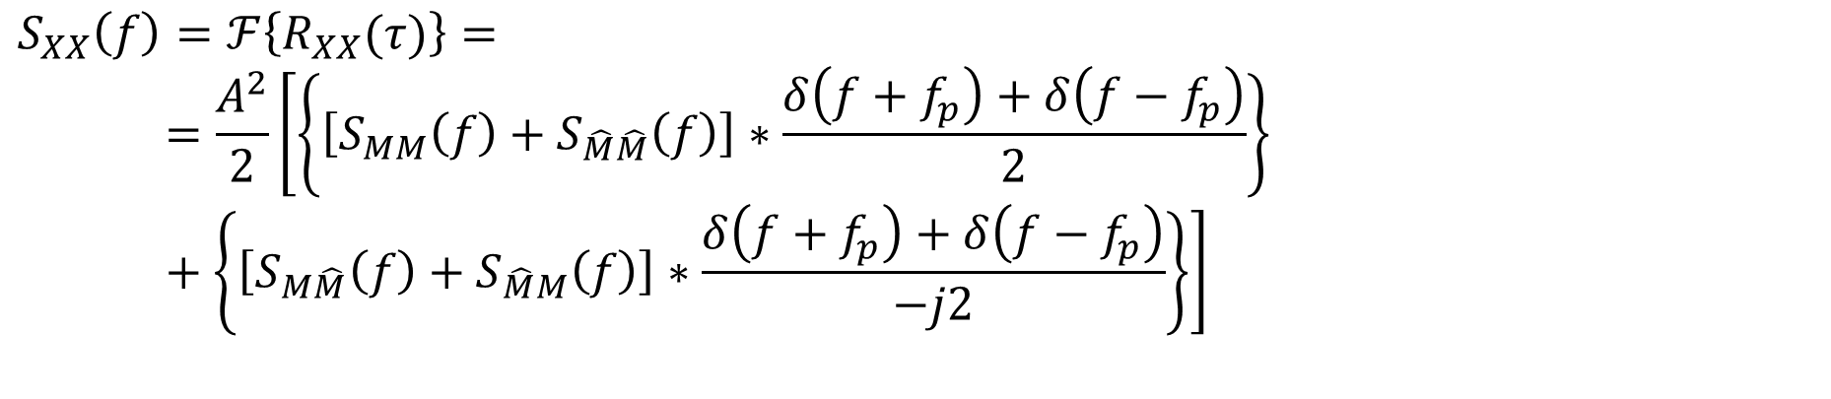

$$S_{XX}\left(f\right)=ℱ\left\{R_{XX}(τ)\right\}=$$
    $$=\frac{A^{2}}{2}\left[\left\{\left[S_{MM}\left(f\right)+S_{\hat{M}\hat{M}}\left(f\right)\right]∗\frac{δ\left(f+f_{p}\right)+δ\left(f−f_{p}\right)}{2}\right\}+\left\{\left[S_{M\hat{M}}\left(f\right)+S_{\hat{M}M}\left(f\right)\right]∗\frac{δ\left(f+f_{p}\right)+δ\left(f−f_{p}\right)}{−j2}\right\}\right]$$
$$S_{MM}\left(f\right)$$
$${S_{\hat{M}M}}^{∗}\left(f\right)$$
$$−j2Im\left\{S_{\hat{M}M}\left(f\right)\right\}=j2S_{MM}\left(f\right)sign(f)$$
$$S_{XX}\left(f\right)=\frac{A^{2}}{2}\left[S_{MM}\left(f+f_{p}\right)\left(1−sign\left(f+f_{p}\right)\right)+S_{MM}\left(f−f_{p}\right)\right]\left(1+sign\left(f+f_{p}\right)\right)$$

